Slide 1
600 cm
P
PHYSICAL
V
VIRTUAL
4
3
5
600 cm
2
6
1
7
0
200 cm

Slide 3
S_{I} = 1250 kB
M_{P} = 5 P-frames
S_{P} = 250 kB
…
T
1/R_{F}
D
D
D
D
D
D
D
S
U
U
T
TDD FRAME SIZE OF 10 TIME SLOTS

Slide 4
3.5 GHz
26 GHz
BS
BS
UE
UE
4.283 cm
0.577 cm
4.283 cm
0.577 cm

Slide 5
20 cm
20 cm
4.283 cm
4.283 cm
20 cm
0.577 cm
0.577 cm

Slide 6
BS
HMD
CAM

Slide 7
20 cm
BS
20 cm
0.577 cm
0.577 cm
HMD
TBD
CAM
TBD

Slide 8
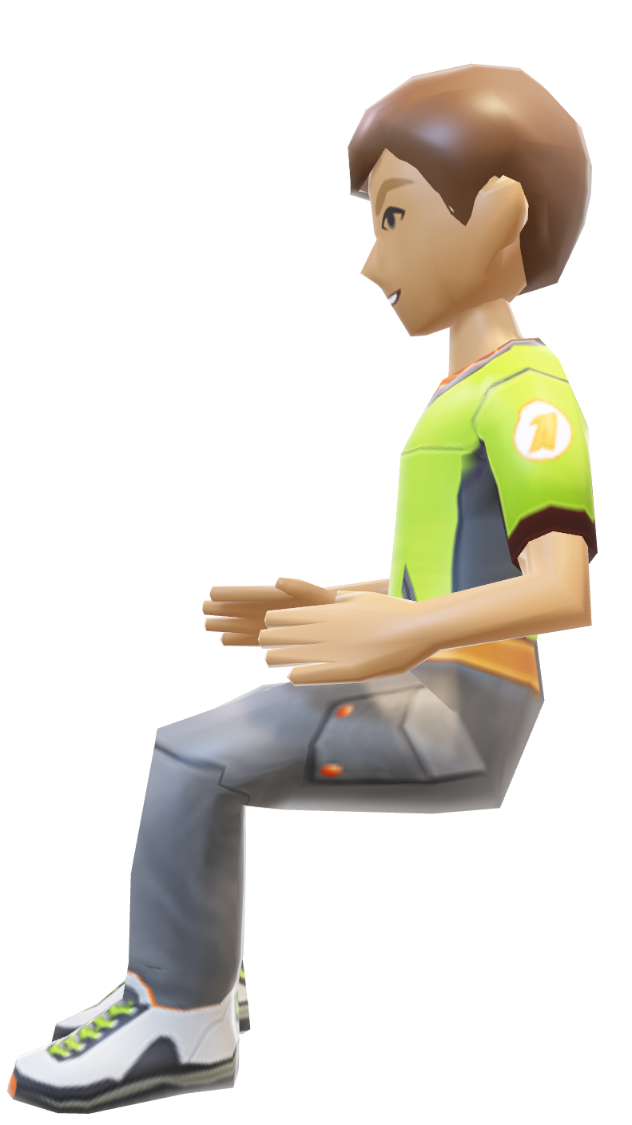

HEAD ORIENTATION
VIDEO CAPTURE DEVICES
HEAD-MOUNTED DISPLAY WITH INCORPORATED UE
HEAD POSITION
CAMERA HUB WITH INCORPORATED UE

Slide 9


MEDIA PROCESSING CLOUD
VIDEO CAPTURE DEVICES
HEAD-MOUNTED DISPLAY WITH INCORPORATED UE
VIRTUAL PARTICIPANTS
CAMERA HUB WITH INCORPORATED UE

Slide 10
MEDIA PROCESSING CLOUD
HEAD ORIENTATION
VIDEO CAPTURE DEVICES
HEAD-MOUNTED DISPLAY WITH INCORPORATED UE
HEAD POSITION
VIRTUAL PARTICIPANTS
CAMERA HUB WITH INCORPORATED UE

